Slide 1
Animal Cells

Slide 2
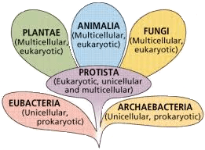
In this Smart Lesson, you will be doing the following:
1. | Recalling that animal cells are eukaryotic.
2. | Identifying the organelles in animal cells.
3. | Describing the functions of animal cell organelles.

Slide 3
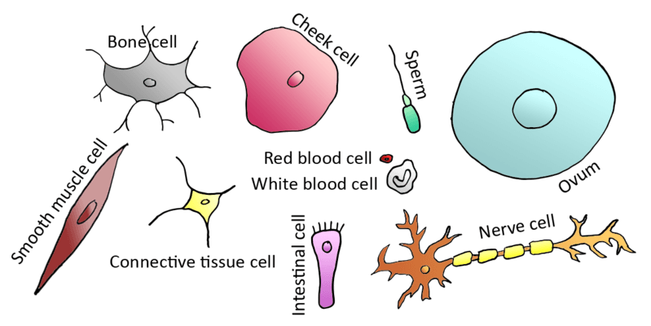
Humans are classified as animals, which means we are made up of animal cells.
All animals are multicellular, made up of many different types of cells. For example, your bones are made up of bone cells, your skin is made up of skin cells, and your brain is made up of brain cells.

Slide 4
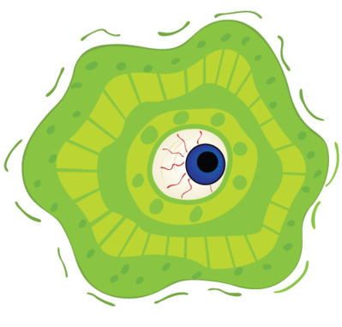
Why are all the cells in your body not the same?
Well, your body wouldn't function very well if you were only made up of eye cells!
Since humans are much larger than bacteria, we need different cells to carry out different functions. We are made up of specialised cells that are programmed to have a certain structure because they undergo a certain function.
For example, some of your eye cells are built in a way that they can sense patterns of light and send these patterns as a message for your brain to interpret. Pretty cool stuff!

Slide 5
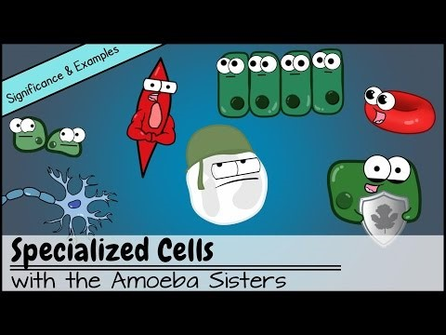

Slide 6
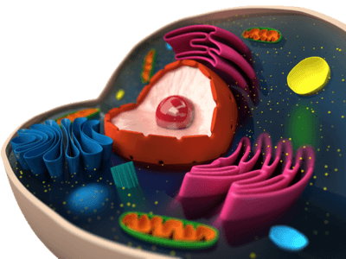
All animal cells have the same basic structure. They all have the same organelles inside them.
Remember that organelles are the smaller parts of cells that each have a special function, just like the organs that make up our bodies! Organelle means "little organ".

Slide 7
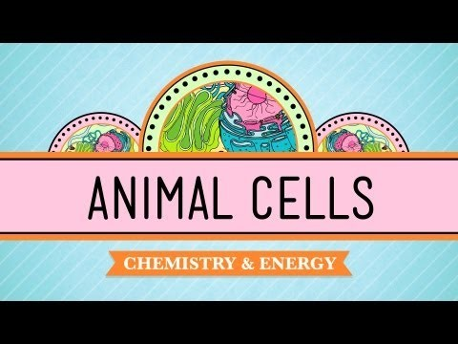

Slide 8
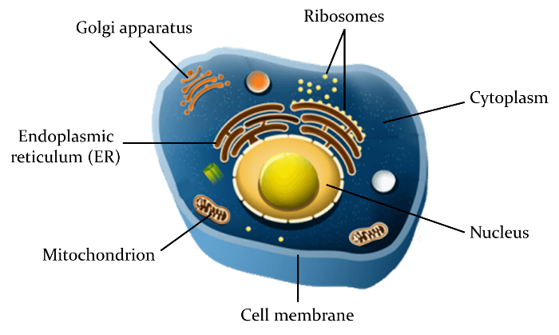
Generally, most animal cells will contain the following organelles.

Slide 9
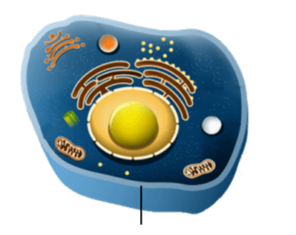
The first organelle we will examine is the cell membrane.
This is like the gate-keeper of the cell, because it determines which substances can enter and exit the cell. Things like oxygen and food are essential to the cell's functioning, so they easily get past the cell membrane. Toxins and drugs are often blocked because they could harm the cell.
Here is where the cell membrane is located in a generalised animal cell:

Slide 10

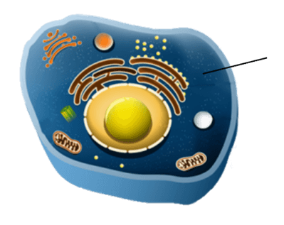
Inside the cell we find a jelly-like substance called cytoplasm.
Cytoplasm helps the cell hold its shape, and also allows nutrients and organelles to move around in it.
Here is where the cytoplasm is located in a generalised animal cell:

Slide 11
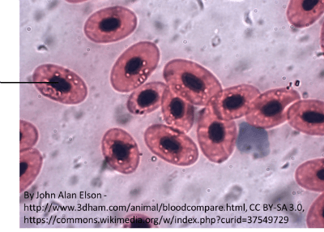
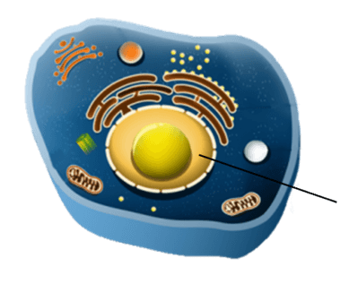
The nucleus is the control centre of the cell. The genetic material (DNA) that contains the instructions for all the other parts of the cell is located inside the nucleus.
Here is where the nucleus is located in a generalised animal cell:
And here is where the nucleus is located in frog red blood cells:

Slide 12
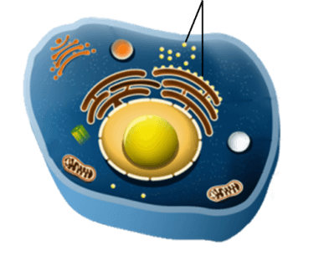
Ribosomes are the organelles responsible for building proteins that the cell can use, so they can be thought of as small factories within the cell city. Sometimes an individual cell can hold up to ten million ribosomes!
Here is where the ribosomes are located in a generalised animal cell:

Slide 13
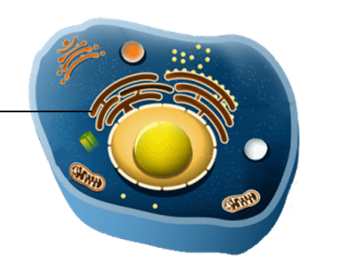
Just outside of the nucleus, we will drive into the cell city's highway system, an organelle called the endoplasmic reticulum (ER).
This may sound like a complicated name, but if we break it down we see it means exactly what it does. Endo means internal; plasm is from cytoplasm; and reticulum means network. The ER is a network of tubules containing cytoplasm that transports proteins around the cell!
Here is where the endoplasmic reticulum is located in a generalised animal cell:

Slide 14

If we follow a protein as it leaves the endoplasmic reticulum, we will be taken to the Golgi apparatus (Golgi body).
The Golgi apparatus folds proteins into their correct shape, modifies them if needed (such as adding a sugar group), packages them and sends them on to where they are needed in the cell. It is like the post office of the cell city.
Here is where the Golgi apparatus is located in a generalised animal cell:

Slide 15
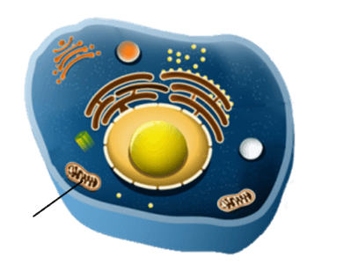
Mitochondria produce the energy that is required for all of the other processes that go on in the cell!
Here is where a mitochondrion is located in a generalised animal cell:

